Slide 1
Secure Coding Practices

Slide 2
Outline
Security Requirements
Encryption
Never Trust System Input
Encoding and Escaping
Third-Party Components
Security Headers: Seatbelts for Web Apps
Securing Your Cookies, Passwords, Storage, and Other Important Decisions
HTTPS Everywhere

Slide 3
Outline
Framework Security Features
File Uploads
Errors and Logging
Input Validation and Sanitization
Authorization and Authentication
Parameterized Queries
Least Privilege,
Requirements Checklist
Self-learning Topics: OWASP Secure Coding Practices

Slide 4
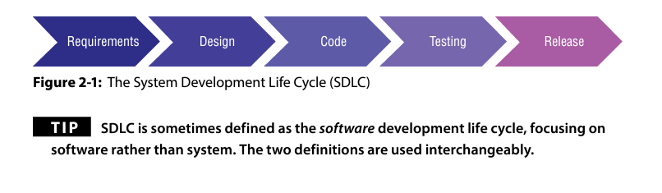
Software Development Lifecycle
Notes:
When you have your very first project meeting (often called a “project kickoff meeting”), there should be a person from the security team present, to take part in the project from its very inception. Even though this person will not be working full time on the project, they should be part of the team and make themselves available regularly to ensure that all security questions and concerns are addressed in a timely manner. Assigning a security person to a project team is sometimes called the partnership model or the person is referring to as being “matrixed into the team.” No matter what you call it, this person is there to ensure that security’s interests (CIA) are represented throughout the entire project.

Slide 5
Requirements
Software project requirements should always include security questions. Following are the types of questions that security professionals should be asking when assisting with requirements gathering and analysis:
Does the system contain, or come in contact with, confidential, sensitive, or Personally Identifiable Information (PII) data?
Where and how is the data being stored? Will this application be available to the public (internet) or internally only (intranet)?
Does this application perform sensitive or essential tasks (such as transferring money, unlocking doors, or delivering medicine)?
Does this application perform any risky software activities (such as allowing users to upload files)?
What level of availability do you need?
Does it require 99.999% up time? (Note: almost no systems actually require that level of up time.)

Slide 6
Encryption
Encryption is two‑way, in that you can jumble up the information into an unreadable mess, and then “decrypt” it back into its original form.
In order to ensure the confidentiality of your data, it should be encrypted in transit (on its way to and from the user, the database, an API, etc.) and at rest (while in the database).
if someone were to gain unauthorized access to your data or intercept your traffic with a sniffing tool, they would not be able to understand what they have found.
This does not, however, protect the availability of your data, or its integrity.

Slide 7
protecting your secrets (the “C” in CIA) is vital, and thus no matter what system you are creating, you will want to ensure the data is encrypted (not hashed) in transit and at rest.
Some may argue that data should even be encrypted while in use (in memory), but unless you are dealing with extremely sensitive data, this is generally not expected as a project requirement.
To protect highly sensitive data, it is recommended that you flush the memory when your program exits, logs out, or is otherwise ended.

Slide 8
Never Trust System Input
Any input to your system could potentially be tampered with or otherwise cause your application to malfunction or fail.
Your program must be able to handle every type of input gracefully, even bad input.
Input to your application means literally anything and everything that is not a part of your application or that could have been manipulated outside of your application.

Slide 9
Following are examples of input to your application:
User input on the screen (for instance, entering search phrases into a field)
Information from a database (even the database you designed for your app)
Information from an API (even one you wrote)
Information from another application that your application integrates with or otherwise accepts input from (this includes serverless apps and scripts)
Values in the URL parameters, cookie values, configuration files
Data or commands from cloud workflows
Images that you’ve included from other sites (with or without permission)
Values used from online storage

Slide 10
Examples of parts of your application that could be manipulated outside of your program include:
URL parameters (a user could change them)
Information in a cookie that does not have the “secure” and “HTTPS only” flags set
Hidden fields (they are not safe from attackers)
HTTPS request headers
Values entered on the screen that can be manipulated after they have passed your JavaScript validation if using a web proxy (more on this later in the chapter)
Front-end frameworks that are not included as part of your project but instead hosted elsewhere on the internet and called from your application in real time
Third-party code that you include in your application when it is compiled (libraries, includes, frameworks, etc.)
Images that you include in your application that are hosted elsewhere on the internet
Configuration files that are not managed by you
APIs or any other service that your application calls
Scripts that you do not control

Slide 11
Validation
In order to effectively apply the concept “never trust system input” you must always validate all input (every single time) before you use the input.
You are expecting a date of birth, so you verify that the value you receive is indeed in date format and/or convert it into date format, and that it is within the previous 100 years (for example, age > current year – 100 && age < current year). If it is not in proper date format (“aaaaaaaa” for example), you reject it.
The field is a person’s first name, and you have dedicated 80 characters for this field. Verify that the input you receive is 80 characters or less, and that the characters are appropriate for a name. For instance, if it contains %, [, {, <, or |, it is unlikely to be a real name, and you should reject this input with an appropriate error message
O’Connor

Slide 12
The field is an email address; there are regular expressions available online for validating email addresses, and validators in your framework.
Your program does a search in the database and displays a string from the record it found to the screen. Validate that this input is what you are expecting, just as you would if it came from a user.
You call an API; you send a postal code, and it returns the rest of the address. Verify that the address is in the correct format and is what you are expecting.
An application calls your application and passes a URL in the parameters. This is a dangerous action from a security perspective and is generally referred to as an open redirect. Whenever possible, your application should only accept information from other applications over secure channels (TLS), and you should also validate the data they send you.
If you are writing an application in a language that is not memory-safe (for example, C/C++), you will need to do something called bounds checking7 to ensure the input does not overflow your variable types.

Slide 13
Encoding and Escaping
Escaping a character or value means removing the special powers that it would have if it were executed as code, instead of being treated as data (as it should be). It is usually done by adding a backslash (\) character before the special character in question.
Encoding is changing a value from whatever format it is in into whatever format you are encoding for (URL encoding, base64 encoding, HTML encoding).
The purpose of encoding is not to protect the value you are encoding, but to change it into the format that you want to use it as.
The output encoding will ensure that if the value that you are outputting to the screen contains code (such as a cross-site scripting attack), it will only output the text value, not interpret (execute) the code in the browser as JavaScript. Output encoding renders XSS attack code powerless.

Slide 14
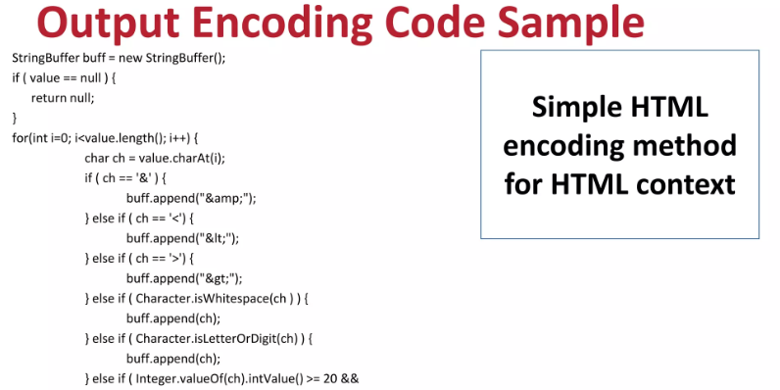

Slide 15
Third-Party Components
A third party component is basically a software solution that is developed by another company or developer. When we’re building custom software systems, we don’t like to reinvent the wheel. So if a third party app exists that meets your functionality needs without us having to build it from scratch
every line of code you include from a library, frame‑ work, plugin, or other third-party component is risk that you accept into your application; if it is insecure your application is now also insecure if it accesses/ uses/calls that part of the component.
Verifying that all third-party components are not known to be vulnerable is a quick-and-easy win in regard to understanding how secure your application is.
There are many, many tools on the market that can verify if your third-party components are known to be vulnerable.

Slide 16
Strategies to evaluate third party components
If you can afford it, use two tools, not one. They all check different databases and in different ways, and therefore may not catch the same things.
you should regularly scan your code repository (daily, or at least weekly), as well as scan every time you release code to production.
You should scan every time you release your code because you (or your teammates) may have added a new component or upgraded a component to a version that is known to be vulnerable but not realized it.
If you are building software that requires a very high level of assurance, you should test and review every single line of code that your application depends on.
A best practice when it comes to third-party components is to only include the ones that you need, as opposed to including every cool new thing you see on the internet.
Notes:
There are many, many tools on the market that can verify if your third-party components are known to be vulnerable. This book is not going to recommend specific tools or vendors, but instead it will offer strategic uses of such tools. The first strategy is that if you can afford it, use two tools, not one. They all check different databases and in different ways, and therefore may not catch the same things. The second strategy is that you should regularly scan your code repository (daily, or at least weekly), as well as scan every time you release code to production. You should scan your repository because some of your applications will be published rarely, but new vulnerabilities are still being Chapter 2 ■ Security Requirements 31 found all the time. The older the components are that you are including in your code, the more time there has been for security researchers and malicious actors to review them, and potentially find vulnerabilities in them. You should scan every time you release your code because you (or your teammates) may have added a new component or upgraded a component to a version that is known to be vulnerable but not realized it. Building this into your CI/CD pipeline (or whatever other process you use to publish your code) would protect you from unintentionally including harmful third-party code. Note that this step is the scan for known vulnerabilities in third-party code. There are likely to be more vulnerabilities that remain unknown. Checking for known vulnerabilities is the bare minimum in regard to creating secure software. If you are building software that requires a very high level of assurance, you should test and review every single line of code that your application depends on. A best practice when it comes to third-party components is to only include the ones that you need, as opposed to including every cool new thing you see on the internet. Although this will be a tough sell with developers (let’s face it, new tech is exciting and fun), if you can explain the risks involved and pro‑ pose an alternative or solution, rather than just saying no, you are more likely to have positive results.

Slide 17
Security Headers: Seatbelts for Web Apps
Security headers are settings that tell the browser and server how to handle various things for your web application; they only apply to web assets that use a browser (web apps and Software as a Service, or SaaS, products that are accessed via a browser).
They do not apply to software that you install on your computer, operating systems, or embedded systems like firmware.
Security headers are a lot like seatbelts; they aren’t exciting, they aren’t difficult to use or time consuming, and if you create a habit of using them, they can save you in an emergency.
the web server or your code. To apply them you generally will add one line of code or check a box to configure your web server

Slide 18
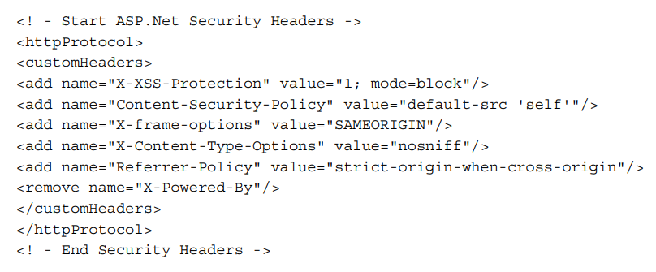
Different Security Headers

Slide 19
X-XSS-Protection
The X-XSS-Protection header is used to enable the built-in XSS filter in modern web browsers. When a browser detects a potential XSS attack, it can either sanitize the page by removing the malicious script or block the page entirely.
This header has been deprecated.
Not only is it no longer supported by modern browsers, but it is recommended by several industry experts that it should no longer be used at all, due to the vulnerabilities it can create.
Although it can help in some cases with some very old browsers, it causes more harm than good, and therefore should no longer be used as of this writing.

Slide 20
Securing Your Cookies, Passwords, Storage, and Other Important Decisions
Cookies are used to pass information about a user session back and forth from the browser to your web server and can be saved for future use to give the user a more personalized experience (for instance, it can remember their language preference).
Although many websites use cookies to store information for marketing and tracking purposes, and even selling the information to other companies, the ethical aspects in regard to privacy of the data kept within cookies is not a topic we will delve into here.
When you are setting cookies in your application, there are settings that you will need to use in order to ensure the data within your cookie remains safe

Slide 21
Techniques to secure cookies
The Secure Flag
The HttpOnly Flag
Persistence
Domain
Path
Same-Site
Data Privacy
Data Classification

Slide 22
The secure flag
The secure flag ensures that your cookie will only be sent over encrypted (HTTPS) channels.
If an attacker attempts to downgrade your session to HTTP, your web application will refuse to send the cookie.
You should always turn this setting on:
Set-Cookie: Secure; (plus all of your other settings)

Slide 23
The HttpOnly Flag
When this flag is set on a cookie it means that the cookie cannot be accessed via JavaScript; it can only be changed on the server side.
The reason for using this setting on your cookie is to protect against XSS attacks attempting to access the values in your cookie.
Set-Cookie: HttpOnly; (plus all of your other settings)

Slide 24
Persistence
If you are collecting sensitive user data or managing your session, your cookie should not be persistent; it should self‑destruct at the end of the session to protect that data.
A cookie that self‑destructs at the end of your session is a called a “session cookie.”
If the cookie does not self‑destruct at the end of the session, it is called a “persistent cookie” or a “tracking cookie.”
For persistent cookies, you can set the expiry via the “expires” attribute setting, and/or set a specific maximum age that the cookie can reach via “max‑age” setting.
Expires: Jan 1, 2021 Set-Cookie:
Expires=Mon, 1st Jan 2021 00:00:00 GMT;
Max-age of 1 hour Set-Cookie:
Max-Age=3600; (plus all of your other settings)

Slide 25
Domain
If you want your cookie to be able to be accessed by domains outside of your own, you must explicitly list them as trusted domains using the “domain” attribute.
Otherwise browsers will assume your cookies are “host‑only,” meaning only your domain can access them and it will block all other access.
This type of built‑in protection is considered “secure by default”; if only all software settings worked this way!
Set-Cookie:
Domain=app.NOTwehackpurple.com;
The "Domain" attribute in a Set-Cookie HTTP header does indeed control the scope of the cookie's visibility to other domains, but it doesn't necessarily restrict access only to the specified domain. Instead, it expands the cookie's accessibility to subdomains of the specified domain.

Slide 26
Path
The "Path" attribute in a Set-Cookie HTTP header allows you to specify the URL path for which the cookie should be sent in future requests.
It's a way to restrict the scope of the cookie to a specific directory or area within your website or web application.
Set-Cookie:
path=/YourApplicationsPath; (plus all of your other settings)

Slide 27
Same-Site
The "SameSite" attribute in a Set-Cookie HTTP header is used to control whether cookies should be restricted to first-party or same-site contexts.
This attribute helps mitigate certain types of cross-site request forgery (CSRF) and cross-site scripting (XSS) attacks by providing more control over how cookies are sent in cross-origin requests.
If a cookie is set with "SameSite=Strict", it will only be sent in a first-party context.
If a cookie is set with "SameSite=Lax", it will be sent along with cross-origin GET requests, such as when navigating to a link from an external site, but not with cross-origin POST requests, which are typically used for actions like form submissions.
Notes:
SameSite Attribute Values:
"Strict": If a cookie is set with "SameSite=Strict", it will only be sent in a first-party context. This means the cookie will only be sent along with requests initiated from the same site as the domain that set the cookie.
"Lax": If a cookie is set with "SameSite=Lax", it will be sent along with cross-origin GET requests, such as when navigating to a link from an external site, but not with cross-origin POST requests, which are typically used for actions like form submissions.
"None": If a cookie is set with "SameSite=None", it will be sent in both first-party and cross-origin contexts. However, when setting "SameSite=None", the cookie must also be marked as "Secure" (sent only over HTTPS) to prevent it from being sent over unencrypted connections.

Slide 28
Data Privacy
Most websites now have a privacy policy stating that websites must state which data they are collecting and how they are using it.
If your workplace has such a policy, ensure you follow it.
If your workplace doesn’t, perhaps you need one.
Information We Collect:
Personal Information:
Usage Information:
Cookies and Similar Technologies:
How We Use Your Information:
To Provide Services:
Marketing and Communications
Analytics:
Information Sharing:
Third-Party Service Providers:
Legal Compliance:
Notes:
Information We Collect:
Personal Information: When you interact with us, we may collect personal information such as your name, email address, phone number, and job title.
Usage Information: We may collect information about how you interact with our website, products, and services, including IP addresses, browser types, and device identifiers.
Cookies and Similar Technologies: We use cookies and similar technologies to enhance your experience, analyze trends, and personalize content and advertising.
How We Use Your Information:
To Provide Services: We use your information to provide and improve our products and services, respond to inquiries, and communicate with you about your account.
Marketing and Communications: With your consent, we may send you promotional materials and other communications about our products, services, and events.
Analytics: We may use your information to analyze trends, track user activities, and gather demographic information for internal purposes.
Information Sharing:
Third-Party Service Providers: We may share your information with trusted third-party service providers who assist us in operating our website, conducting business, or servicing you.
Legal Compliance: We may disclose your information as required by law, regulation, or legal process, or to protect our rights, property, or safety.

Slide 29
Data Classification
All data collected, used, or created by your application must be classified and labeled to ensure that anyone doing work on your project knows how to handle the data.
Depending upon which country you live in and where you work (private company or governmental agency), the classification system you use may be different. Ask your privacy or security team if you need guidance.

Slide 30
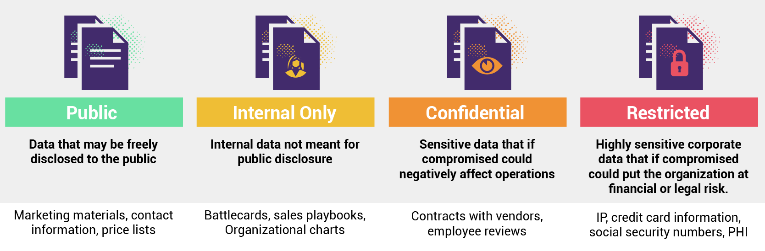

Slide 31
Passwords, Storage, and Other Important Decisions

Slide 32
How to manage your passwords? (password manager)
A password manager is software that securely stores users’ passwords and helps them create unique, long, and complex passwords.
People use password managers so they don’t need to remember several passwords; they just need the single password that they use to get into the manager
Most password managers have plugins for your browsers so that once you sign into the password manager you just press a button to log in to any site you are visiting.
Password managers also usually have an area to take secure notes
if one of the websites you use has a data breach and their users’ usernames and passwords (known as “credentials”) are leaked onto the internet or fall into the hands of malicious actors, it will only affect one single account, not all of your accounts.

Slide 33
Secret stores
They are built for computer systems to use, not people.
A secret store is a software vault that encrypts your secrets, and then allows your application to access them programmatically
You can store certificates, credentials (username and password), connection strings, hashes, and anything else that you consider a “secret” that your application will use.

Slide 34
Service accounts
When you create an application and it needs to access a database, you should create a service account for your application to connect to the database, rather than using your own account.
your account likely has lots of permissions all over the place, and if someone got into your account they could take over all of the apps too
You should always ensure you practice least privilege when creating and enabling service accounts.

Slide 35
How to store password
salted and hashed format
Newer techniques for ensuring that passwords are extremely difficult to crack include “work factor” and “peppering.”
The "work factor" refers to the number of iterations or the complexity of the algorithm, which can be adjusted to make the hashing process more time-consuming and resource-intensive. As computational power increases over time, increasing the work factor ensures that password hashes remain resistant to brute-force attacks.
Peppering is similar to a salt in that it is added to a password before the password is hashed and it should be generated by a secure random number generator. A pepper is a secret and should not be stored in the database like a salt, it should be quite long, and the pepper is unique for each application
Notes:
If you recall from earlier, hashing means a one‑way cryptographic process, it cannot be undone. The process of salting is adding a unique, long value to a value before you hash it, in order to increase entropy and to make it even more difficult for a potential attacker to crack or guess a password. This means that when your application has a user login, it will run the hashing and salting functions against the value the user entered, then compare the result to what is stored in the database.

Slide 36
Some more precautions
Ensure passwords for your application’s users are long
The longer the better; encourage use of passphrases.
Do not force users to change their passwords after a certain amount of time, unless a breach is suspected.
Never verify if it was the username or password that was incorrect when alerting the user that they have failed when logging in.
Forgotten password features should verify the user’s identity before sending a password reset link via email or SMS, either by using another form of authentication or security questions.
Never allow the user to reset the password directly on your system; always send it using an “out of band” form of communication as a second form of authentication.
The reset link should be one‑use only, and expire within 1 hour if not used.

Slide 37
Rules for Passwords
Hash and salt all user passwords. Make the salt at least 28 characters.
All application secrets must be stored in a secret store.
All accounts used within the application must be service accounts. They must be unique for each application and should follow the concept of least privilege.
Have all people on your team use password managers.
Turn on MFA for all important accounts.
Do not force password changes on a schedule, only after a breach or suspicious activity.

Slide 38
HTTPS Everywhere
Only allow your site to be accessible via HTTPS.
Redirect from HTTP to HTTPS.
If someone attempts to downgrade a connection, redirect them.
This can be done via security headers in your code, or settings on your server.
Ensure you are using the latest version of TLS for encryption.
For TLS recommendations see: bettercrypto.org/#webservers and https:// ssl-config.mozilla.org
For assistance in compatibility Configuration see: wiki.mozilla.org/ Security/Server_Side_TLS To
test your configuration see: testssl.sh

Slide 39
Framework Security Features
Frameworks often come equipped with a variety of security features to help developers build secure applications more easily. Here are some common security features found in modern frameworks:
Authentication and Authorization
Cross-Site Scripting (XSS) Protection
Cross-Site Request Forgery (CSRF) Protection
SQL Injection Prevention
Session Management
Input Validation and Sanitization
Content Security Policy (CSP)
Rate Limiting and Throttling
Developers should stay informed about emerging security threats and regularly update their applications and dependencies to address known vulnerabilities.
Notes:
Authentication and Authorization: Most frameworks provide built-in mechanisms for user authentication and authorization. This includes features such as user authentication via username/password or third-party providers (OAuth, OpenID), as well as role-based access control (RBAC) for defining and enforcing user permissions.
Cross-Site Scripting (XSS) Protection: XSS is a common web security vulnerability. Frameworks often include features to automatically sanitize user input and output to prevent XSS attacks. This can include HTML escaping, input validation, and output encoding.
Cross-Site Request Forgery (CSRF) Protection: CSRF protection helps prevent attackers from tricking users into performing unintended actions on a web application. Frameworks may provide CSRF tokens or built-in middleware to automatically validate and mitigate CSRF attacks.
SQL Injection Prevention: SQL injection is a serious security vulnerability that can lead to unauthorized access to databases. Frameworks typically provide features like parameterized queries, ORM (Object-Relational Mapping) libraries, or query builders to prevent SQL injection attacks.
Session Management: Frameworks often include built-in session management functionality to securely manage user sessions. This may include session encryption, session ID regeneration, and session expiration mechanisms to mitigate session-related attacks like session fixation and session hijacking.
Input Validation and Sanitization: Proper input validation and sanitization are crucial for preventing a wide range of security vulnerabilities, including XSS, SQL injection, and command injection. Frameworks may offer validation libraries or built-in validation and sanitization functions to help developers validate and sanitize user input effectively.
HTTPS Support: HTTPS encrypts data transmitted between the client and server, providing confidentiality and integrity protection. Many frameworks offer built-in support for HTTPS, making it easier for developers to enable secure communication between clients and servers.
Content Security Policy (CSP): CSP is a security feature that helps mitigate XSS attacks by allowing developers to specify which resources (e.g., scripts, stylesheets, images) are allowed to be loaded by a web page. Some frameworks provide built-in support for CSP or offer middleware/plugins to help developers implement CSP effectively.
Rate Limiting and Throttling: To prevent abuse and mitigate denial-of-service (DoS) attacks, frameworks may offer rate-limiting and throttling features. These features allow developers to limit the number of requests made by a user or IP address within a certain time period.
Security Headers: Frameworks may provide support for setting security-related HTTP headers, such as Content-Security-Policy, X-Frame-Options, X-XSS-Protection, and X-Content-Type-Options, to help protect against various web security vulnerabilities.
These are just a few examples of the security features commonly found in modern frameworks. It's important for developers to familiarize themselves with the security features provided by their chosen framework and to follow best practices for secure application development. Additionally, developers should stay informed about emerging security threats and regularly update their applications and dependencies to address known vulnerabilities.

Slide 40
File Uploads
If performing a file upload, if at all possible, find a well‑respected third‑party component designed for this purpose to use for this portion of your application
When accepting an uploaded file from a user, assume the worst. Verify its type and size, rename the file, do not allow the user to set the path as to where it would be stored, and store it in a safe place away from the rest of your application and web server.
Once you have accepted the file, scan it with at least one tool that can verify if the file is questionable.
Restrict the files to only specific types that are less dangerous.

Slide 41
cheatsheetseries.owasp.org/ cheatsheets/Protect_FileUpload_Against_Malicious_File.html.
Communications Security Establishment of Canada (CSE), created and open‑sourced a free tool to check uploaded files; it is called AssemblyLine (cyber.gc.ca/en/assemblyline).

Slide 42
Errors and Logging
All errors should be caught and handled gracefully; there should never be a stack trace or database error on the screen.
When errors happen, an application should never fail into an unknown state. It should always roll back any transaction it was performing, and “close” anything it may have opened
Your security team likely has something called a SIEM, a Security Incident and Event Management system, which ingests all the log files from all of your network tools.
Never log sensitive information, such as passwords, Social Insurance Numbers, complete credit card numbers (last 4 digits are okay), date of birth plus a person’s first and last name, etc.

Slide 43
If an activity happens within your application that appears to be a security event or incident, your app should not only log the situation, but it should raise an alert.
Events that would potentially trigger a security alert include falling into an unknown state, having access denied to a feature or document, a workflow bypass attempt, a user exceeding usage quotas (for instance, attempting to log in 10 times in 1 second, or 100 times in an hour—human beings do not act like this), the application crashing, a user using a certain (large) amount of bandwidth, CPU, or storage, calls to an HTTP verb that you have blocked, etc.
You will need to decide what is appropriate for your organization and your application with the business analysts and security team.

Slide 44
Authorization and Authentication
Authorization
If your application has different types of access for different types of users, generally referred to as Role‑Based Access Control (RBAC), then you must define all of it during the requirements phase. You do not want these changing on you as you are developing the system, it will make your job more difficult than necessary.
Authentication
How will your system verify the identity of the users?
How will you track their identity?
Do you need to track it across several systems or just your website?
Deciding all of these systems now is ideal, but during the design phase is also acceptable.

Slide 45
Parameterized Queries
Parameterized queries are an essential technique for developing secure applications, particularly when interacting with databases. They help prevent SQL injection attacks, a prevalent and dangerous type of security vulnerability.
Protection Against SQL Injection
Automatic Data Sanitization
Improved Performance and Maintainability
Support Across Different Database Systems

Slide 46
Least Privilege
The service account that calls your database from your application should only have CRUD permissions, never database owner (DBO).
Ideally one service account will have read‑only, for “select” calls, while another will have CRUD access when insert, update, or delete is required. Use the read‑only account whenever possible.
Create a different service account for each API that your application uses, with each one only having the maximum‑required permissions (for instance, only “select” or “read” if it is only expected to return data, not modify data).
Only give your team members access to read/write your projects within your code library, with everyone else only having read access or no access at all if your code is potentially quite sensitive or valuable in nature.

Slide 47
Requirements Checklist
Below is a checklist that you can use for all your web application projects.
Encrypt all data at rest (while in the database).
Encrypt all data in transit (on its way to and from the user, the database, an API, etc.).
Trust no one: validate (and sanitize if specialize circumstances apply) all data, even from your own database.
Encode (and escape if need be) all output.
Scan all libraries and third‑party components for known vulnerabilities before use, and regularly after use (new vulnerabilities and versions are released all the time).

Slide 48
Use all applicable security headers.
Use appropriate secure cookie settings.
Classify and label all data that your application will store, collect, or create.
Hash and salt all user passwords. Make the salt at least 28 characters.
Store all application secrets in a secret store.
Ensure all accounts used within the application are service accounts (not a human being’s account).
Have all people on your team use password managers and never reuse passwords.
Turn on MFA for all important accounts.
Do not force password changes on a schedule, but only after a breach or suspicious activity.
Only allow public‑facing (internet) sites to be accessible via HTTPS. Redirect from HTTP to HTTPS. Ideally this would be applied to both internal and external applications.
Ensure you are using the latest version of TLS for encryption

Slide 49
If performing a file upload, ensure you are following the advice from OWASP for this highly risky activity.
Never put sensitive information in comments. This includes connection strings and passwords; those belong in a secret store.
Ensure all errors are logged (but do not log sensitive information), and if any security errors happen, trigger an alert.
Ensure all errors provide generic information to the user, never information from a stack trace, query fail, or other technically specific information.
Define specifics on role‑based access in the project requirements.
Ensure specifics on authentication methods and identity systems are defined in the project requirements.
Only use parameterized queries, never inline SQL/NOSQL.

